Slide 1
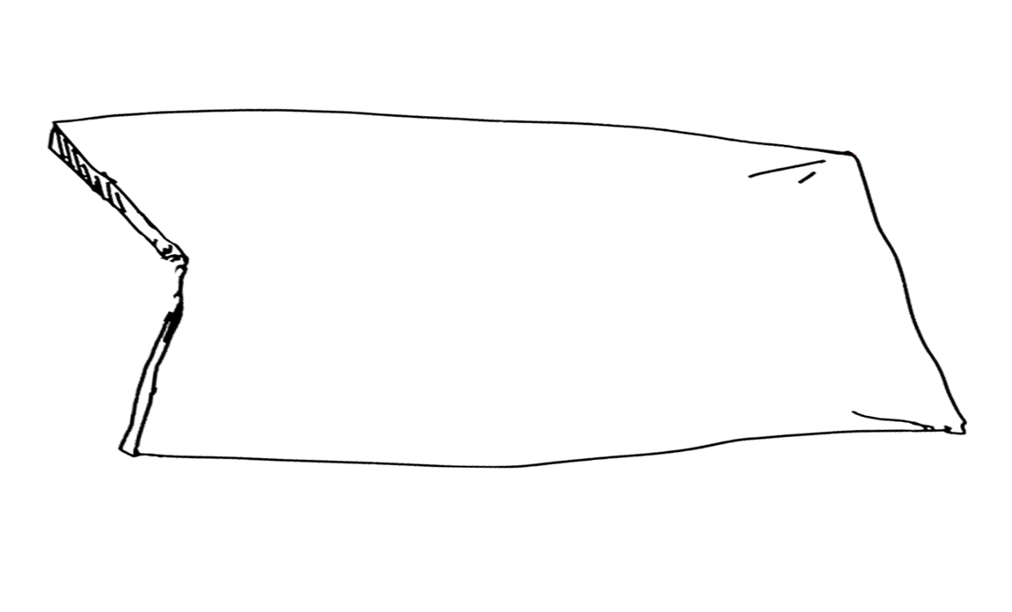
语法课
倒装句
Inversion

Slide 2

主谓顺序
什么是倒装句？
为什么要倒装？
1. 表示强调。
2. 承上启下。
3. 平衡结构
4. 增强句子的表现力。
5. 制造悬念，渲染气氛。

Slide 3

倒装句的类型
完全倒装
部分倒装
特殊倒装

Slide 4
完全倒装
(complete inversion)
倒装(inversion)
谓语
主语
整个________在________前的句子
部分倒装
(partial inversion)
部分谓语（情态动词、助动词、连系动词（be））在前，谓语的主体部分仍在主语之后.

Slide 5
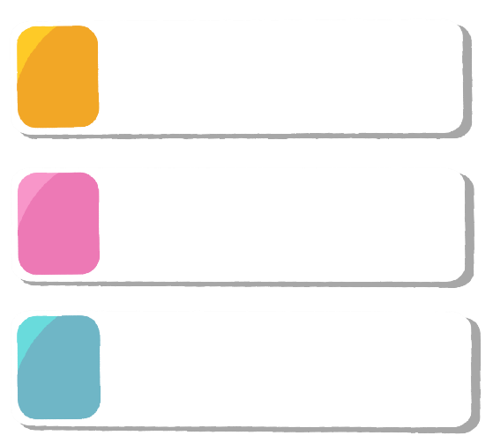
【把全部谓语放在主语前面。】
完全倒装
副词
代表词：Now, then, up, down, here, there...
介词短语
表示地点或者方位的介词短语放在句首
表语前置
作表语的形容词（adj.）或分词(-ed/ -ing)开头
直接引语
直接引语的一部分或全部放在句首时

Slide 6
Complete inversion（完全倒装）
Rule 1:以here, there, now, then, up, down, in, out, off, away等表示运动方向(时间/空间)的副词置于句首以示强调,句子要全部倒装,谓语动词常用come, go, be, lie, run, rush，stand等。
1.翻译句子:
狗来了。 _____________________
现在到你了。_____________________
Here comes the dog.
Now comes/ is your turn.
2.转换句子:
The girl went away. ➡ ️_____________________
Away went the girl.

Slide 7

3. 注意：
there be结构（there live/ stand/ lie/ exist/ appear/ rise/ remain/ happen/ come/ go等）。
桌子上有三本书。__________________________________________
海边住着一位老渔民。______________________________________
市中心有一座高楼。________________________________________
There are three books on the desk．
There lived an old fisherman near the sea.
There stands a tall building in the center of the town.
—Where is Emmons?
— Oh, ________. A. here he comes B. he here comes C. here does he come D. here comes he
PS: 当主语是_________ 时，句子_________.
人称代词
不用倒装

Slide 8
观察：
️In the Shooting Hall silently sat people from all over of the world.
South of the lake lies a big supermarket.
➡️
Rule 2:表示地点的介词短语位于句首时，用完全倒装。
1.转换句子：A variety of flowers grow inside the garden.
➡ __________________________________________️
Inside the garden grow a variety of flowers.
2. 翻译句子：我们学校前面是一个新建的操场。
➡ ___________________________ a newly-built playground.
In front of our school is
3. On the top of the hill______ where I once visited the monk.
a temple stands B. does a temple stand
C. a temple stands there D. stands a temple

Slide 9
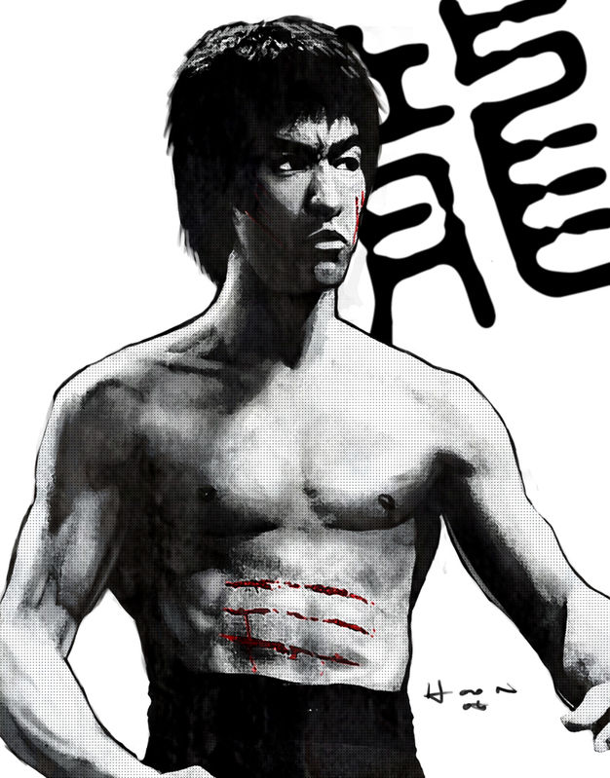
中国人被瞧不起的日子一去不复返了。
The days when Chinese were looked down upon are gone.
➡
____________________________________️
Gone are the days when Chinese were looked down upon.
Rule 3:表语（adj./-ed/ -ing）置于句首时，为了使上下文紧密衔接,常把表语放在句首,倒装结构为：表语＋连系动词＋主语
Standing beside the desk
（站在桌子旁边的）was a teacher.

Slide 10
Rule 4:直接引语的一部分或全部放在句首时，有时用倒装。
eg.“I’ll call again after supper,” said he.（他说）
“Let me go on with the operation.” . (其中一个医生说)
said one of the doctors

Slide 11
巩固运用一（用所给词的正确形式填空）
1. Among the goods (be) Christmas trees, flowers, candles and toys.
2. Standing beside the flowers (be) a teacher.
3. There (be) a tall building on the top of the mountain.
4. There (stand) an ancient tower on the top of the mountain.
5. There at the entrance to the hotel (stand) two guards.
are
is
is
stands
stand

Slide 12
小结：完全倒装
Rule 1:（时间/空间）副词位于句首：here, there, now, then, up, down, in, out, off, away句子要全部倒装,谓语动词常用come, go, be, lie, run, rush，stand等。
Rule 2:（地点/方位）介词短语位于句首: 如：South of ，In front of,On the wall, To the east of,Around his head...
Rule 3:表语（adj.）置于句首时: 表语＋连系动词＋主语
Rule 4:直接引语的一部分或全部放在句首时，有时用倒装。
注意：
当主语为代词时，不倒装。

Slide 13


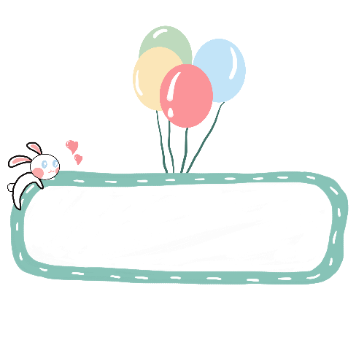
部分倒装
【助v./情v./be动词+主+实义谓语v.】
1. 否定词放句首
2. only + 状语
3. so/such ... that 从句
4. if 引导的虚拟语气省略表达
5. 两个特殊倒装

Slide 14
Rule1. 否定词放句首，用部分倒装
1. 表示否定意义的词 ：
not, never, little, few, seldom, nowhere, neither, nor, hardly, rarely, scarcely
In/ At no time(绝不), By no means(绝不), On no condition(绝不), Under no circumstances(绝不) 等放在句首，用部分倒装。
will I believe what he says. （我绝不会相信他说的话）
have I seen such a moving film.（我从没看过这么感人的电影）
3. else can we find such a comfortable place. （我再也找不到如此舒服的地方了）
4. a single mistake did he make. （他从没犯过错）
By no means
Never
Nowhere
Not

Slide 15
2. 固定句型中含有否定词的倒装:
Hardly/ Scarcely ... when...
no sooner ... than...
not only ... but also...
not until
Neither…nor…

Slide 16
2.1 Hardly/Scarcely…when…/No sooner… than…
一...就
主句倒装，从句不倒装。
1. He had hardly handed in his paper when he realized his mistakes.
➡️
He had no sooner handed in his paper than he realized his mistakes.
➡️
Hardly had he handed in his paper when he realized his mistakes.
No sooner had he handed in his paper than he realized his mistakes.
2. 那个老人刚上公共汽车就有人给他让座。
the old man (get) on the bus someone offered his seat.
Hardly
had
got
when

Slide 17
2.2 not only ... but also...
主句倒装，从句不倒装。
1. 他不仅给我买了一辆自行车，而且还把它送到了我家.
he buy a bike for me sent it to my house.
Not only
did
but he also
2. She not only made a promise, but she also kept it.
➡️
Not only did she make a promise, but she also kept it.

Slide 18
2.3 Not until …
1. The problem will not be settled perfectly until we have had a chance to discuss it.
➡️
Not until we have had a chance to discuss it will the problem be settled perfectly .
2. 直到晚上很晚他才回来。
in the evening he come back.
Not until
late
did
步骤：
Not 放在 until 前
把 not until… 放在句首
主句部分倒装

Slide 19
3. Not until several years ago_____ how serious the pollution was.
people did realize
people realize
didn’t people realize
did people realize

Slide 20
2.3 neither ..., nor ... (既不……, 也不……)
位于句首前后都倒
如果neither和nor分别位于分句句首，则两个分句都要进行部分倒装；
如果neither不位于句首，而nor位于分句句首时，则nor引导的分句进行部分倒装。
eg.:
Neither has he called on her, nor will he do so.
Sam neither has long hair, nor does he wear jeans.

Slide 21
2. only + 状语：only + adv./ 介词短语/状语从句+部分倒装
1. You can learn writing well only in this way.
➡️
2. We can succeed the next time only if we keep on working hard.
➡️
Only in this way can we learn writing well.
Only if we keep on working hard can we succeed the next time.
3. T or F:
① Only she can work out the difficult problem. （ ）
② Only can she work out the difficult problem. （ ）
√
×
➡️当only修饰主语时，句子不用倒装

Slide 22

2.Tell whether the following sentences are right or wrong. If wrong, correct them.
×
(1)Not only does he do well in his lessons, but also does he often help others with their lessons.
helps
√
(2)Not only you but also Tom passed the exam.
前倒后不倒, 连接并列主语时不倒装
×
had she gone
rang.
(3)No sooner did she go out than the telephone had rung.
前倒后不倒, 注意时态
do
×
(4)Neither do I know it, nor I care about it.
前后均倒装
×
(5)Not until did his mother come back did he finish his homework.
his mother came
主句倒装
It was not until his mother came back that he finished his homework.
He didn’t finish his homework until his mother came back.
强调句：？

Slide 23
3. so/such ...(+部分倒装）+ that 从句
so/such ... that 引导的结果状语从句中，如果so/such 放于句首，主句倒装。
结构：So+adj/adv+助v./情v./be动词+主+实义谓语v.+其他+that…
Such+a/an + n. +助v./情v./be动词+主+实义谓语v.+其他+that …
The work was so easy that they finished doing it in just a few days.
➡️
He seemed such a nice man that we all believe him.
➡️
So easy was the work that they finished doing it in just a few days.
Such a nice man did he seem that we all believe him.
Light travels so fast that it is difficult for us to imagine its speed.
➡️
So fast does light travel that it is difficult for us to imagine its speed.

Slide 24
PS: 表示前面提出的情况也同样适用于后面的情况，常用词有so, neither, nor等。
eg.：
She likes music and .
她喜欢音乐，我也喜欢。
If you won't go, .
如果你不去，我也不去。
She hasn't read it and .
她没有读它，我也没有读。
so
do
I
neither
I
will
助动词/ 情态动词/ be动词
nor
have
I
So … sb.: 某某也一样
Neither/nor …sb.:某人也一样不
So sb. …: 的确如此
PS: 区分：so do I. 我也一样。
so it is. 的确如此。

Slide 25
4. if 引导的虚拟语气省略表达
倒装句用于省略 if 的虚拟条件状语从句中。（把从句中的 were, should或 had 提到主语的前面）
If I were you, I would not let her go.
= , ...
If they had helped us, we would not have failed it.
= , ...
If they should come tomorrow, we would finish it.
= ...
Were
I
you
Had
they
helped
us
Should
they
come
tomorrow
步骤：
把if去掉
助v./系v./情态v.提前，其余部分照抄

Slide 26
特殊倒装①
as/though 引导的让步状语从句，“虽然”。
表语(adj./-ed/-ing)/ 状语(adv.)/ v./ (无冠词)名词+as\though+主语+谓语
Although she is young, she can handle it.
➡️
He was praised, but he remained modest.
➡️
Though she is a housewife, she knows a lot about law.
➡️
Young as/though she is, she can handle it.
Praised as/though he was, he remained modest.
Housewife as/though she is, she knows a lot.

Slide 27
小结：
不能和 but 连用。
名词放句首，去掉冠词。
although 不能倒，though 可倒可不倒，as 必须倒。
①. (无冠词)n.+ as + S + v.:
②. adj. + as + S + v.:
③. adv. + as + S + v.:
④. v. + as + S + 情态动词/助动词:
尽管他只是个孩子，他知道的很多。
Child as/though he is, he knows a lot.
尽管我很聪明，但是我很害羞。
Smart as/though I am, I am shy.
尽管他走地很快，但他错过了公交。
Quickly as/though he walked, he missed the bus.
尽管她尽可能地试过了，但她还是没打开门。
Try as/though she might, she didn’t open the door.

Slide 28
特殊倒装②
有些表示“感叹、祝愿”等语气的句子，也可使用倒装结构。
eg.：
a. Isn’t it cold! 天气真冷！
b. May both be happy! 祝你们两位幸福！(May you happy new year!)
c. May God bless you. 愿上帝赐福于你。 d. Long live the king! 国王万岁！ （完全倒装）

Slide 29
总结
倒装
完全倒装
adv.
prep.短语
表语前置
直接引语
部分倒装
句首否定词
only + 状语
so/such... that
if 引导的虚拟语气的省略
特殊倒装
as/though...
表感叹，祝愿

Slide 30
跟踪练习
I.把下列句子改为倒装句
①A beautiful lake lies at the foot of the hill.
②The rocket went up into the air.
③A splendid painting was hanging on the wall.
④I have never seen such a moving film before.
At the foot of the hill lies a beautiful lake.
完全倒装
Up went the rocket into the air.
完全倒装
Hanging on the wall was a splendid painting.
完全倒装
Never have I seen such a moving film before.
部分倒装

Slide 31
⑤The letter you have been looking forward to is here.
⑥He spoke so loudly that every person in the next room could hear him.
⑦He is not only a teacher but also a poet.
⑧I enjoyed the play and my mother enjoyed the play, too.
Here is the letter you have been looking forward to.
完全倒装
So loudly did he speak that every person in the next room could hear him.
部分倒装
Not only is he a teacher, but he is also a poet.
部分倒装
I enjoyed the play and so did my mother.
部分倒装

Slide 32
II.用倒装句翻译下列句子
①现在该轮到你了。
②城南有一家化工厂。
③这个村里住着一位老渔夫。
④只有那时我才知道生活是不易的。
⑤如果他来的话,叫他打电话给我.
Now comes your tum.
South of the city lies a chemical factory.
There lived an old fisherman in the village.
Only then did I see life was not easy.
Should he come,tell him to ring me up．

